Slide 1
Lecture 3
Operations on Sets
CSCI – 1900 Mathematics for Computer Science
Fall 2014
Bill Pine

Slide 2
Lecture Introduction
Reading
  Rosen – Section 2.2
Basic set operations
  Union, Intersection, Complement, Symmetric Difference
Addition principle for sets
Introduction to proofs

Slide 3
Union
The union of sets A and B is the set containing all elements that belong to A or B,
  Denoted as A U B
  A U B = { x | x ∈ A or x ∈ B}
Example
  A = { 1, 2, 3, 4 } and B = { 3, 4, 5, 6 }
  Then A U B = { 1, 2, 3, 4, 5, 6 }

Slide 4
Union
U
1
2
3
4
3
4
3
4
5
6
5
6
A
B
B
A ∪ B

Slide 5
Intersection
The intersection of sets A and B is the set containing all elements that belong to A and belong to B, denoted A ∩ B.
  A ∩ B = { x | x ∈ A and x ∈ B}
Example
  A = { 1, 2, 3, 4 } and B = { 3, 4, 5, 6 }
  Then A ∩ B = { 3, 4 }

Slide 6
Intersection of 2 Sets
U
1
2
3
4
3
4
3
4
5
6
A
B
A∩B

Slide 7
Intersection of 3 Sets
U
A
A∩B
B
C
A∩B∩C
A∩C
B∩C

Slide 8
Union, Intersection and the Universal Set
If A and B are both subsets of the same universal set U then
  A ∩ B ⊆ U
    The intersection of A and B is in the same universal set
  A ∪ B ⊆ U
    The union of A and B is in the same universal set
  A ∩ U = A
    The intersection of A and the universal set is A
  A ∪ U = U
    The union of A with the universal set is U

Slide 9
Union, Intersection and Set Equality
If A and B are both non-empty subsets of the same universal set U then
  If A ∩ B = A ∪ B then A = B

Slide 10
Disjoint Sets
If A and B are both subsets of the same universal set U and A ∩ B = ∅ then A and B have no elements in common and are called disjoint sets
U
A
B

Slide 11

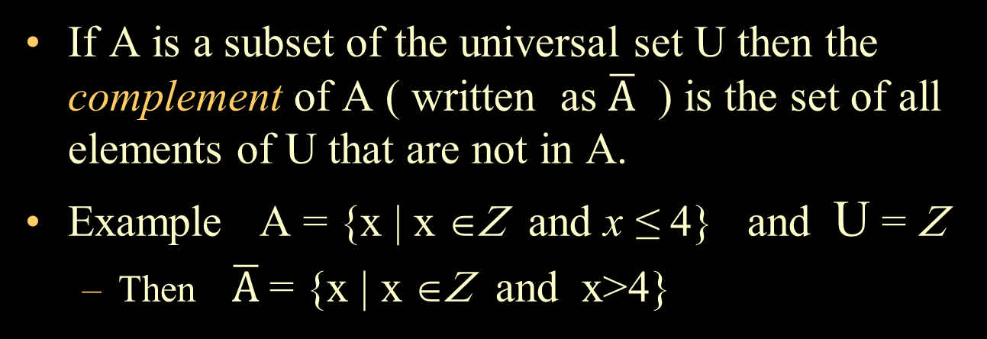
Complement w.r.t. the Universal Set
If A is a subset of the universal set U then the complement of A ( written as $\overline{A}$ ) is the set of all elements of U that are not in A.
Example A = {x | x ∈Ζ and x ≤ 4} and U = Ζ
  Then $\overline{A}$ = {x | x ∈Ζ and x>4}
U
A
$$\overline{A}$$

Slide 12
Complement (or Difference)
A – B = { x | x ∈A and x ∉ B }=
  the complement of B with respect to A
  Everything in A that isn’t in B
Example
A = { 1, 2, 3, 4} and B = { 3, 4, 5, 6 }
  A – B = { 1, 2 }
  B – A = { 5, 6 }

Slide 13
Symmetric Difference
A ⊕ B = (A - B) U (B - A)
Example
Let A = { 1, 2, 3, 4 } and B = { 3, 4, 5, 6 }
  A - B = { 1, 2 }
  B - A = { 5, 6 }
  A ⊕ B = { 1, 2, 5, 6 }

Slide 14
Symmetric Difference
U
1
2
3
4
3
4
3
4
5
6
A
A
B
B
A∩B

Slide 15

De Morgan’s Laws
$\overline{A∪B}= \overline{A} ∩ \overline{B}$
  The complement of the union of two sets A and B is the intersection of the complement of A with the complement of B
$\overline{A∩B}= \overline{A} ∪ \overline{B}$
  The complement of the intersection of two sets A and B is the union of the complement of A with the complement of B

Slide 16
Algebraic Properties of Set Operations
You should read the properties of set operations on pages 8 – 9 of the text
  You can easily verify these properties with a Venn diagram

Slide 17

Inclusion-Exclusion Principle 1
$\left|A∪B\right|= \left|A\right|+ \left|B\right| − \left|A∩B\right|$
Issue: Avoid double counting
U
1
2
3
4
5
6
A
B
A ∪ B

Slide 18
Inclusion-Exclusion Principle 2
|A U B U C|= |A| + |B| + |C|
-|A∩B| - |A∩C| - |B∩C| + |A∩B∩C|
U
I
II
IV
A
A∩B
B
C
A∩B∩C
VII
A∩C
B∩C
V
VI
III

Slide 19
Intersection is a subset of Union
U
1
2
3
4
5
6
A
B
A ∪ B
With the Venn diagram, notice A ∩ B ⊆ A U B
How do we prove this?

Slide 20
Two Example Proofs for A ⊆ B
Prove that the set of all powers of 2 (beginning
with 2) is a subset of the set of all even numbers
Prove that for any two sets A and B that
  A ∩ B ⊆ A U B
Proofs too long for a slide, see
Lecture 3 Handout

Slide 21
Method of Proof: A = B
Given two sets A and B
If the sets are described by enumeration
  Show that they contain the same elements
If the sets are described by their properties
  Show A ⊆ Β and B ⊆ A

Slide 22
Key Concepts Summary
Basic set operations
  Union, Intersection, Complement, Symmetric Difference
Inclusion/Exclusion principle for sets
Introduction to proofs

